Slide 1
To simulate registration of high energy gamma particles in an atmospheric Cherenkov telescope.
K. Naveena | Batch-29

Slide 2
MAGIC Gamma Telescope

Slide 3
Problem Statement
The simple classification accuracy is not meaningful for this data
Since classifying a background event as signal is worse than classifying a signal event as background
g = gamma (signal)
h = hadron (background)

Slide 4
Contents
Data understanding
Data preparation
Insights and Exploration
Model Building
Missing values

Slide 5
Data Understanding

Slide 6
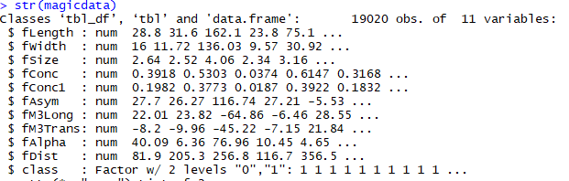
Data structure
19020 observations of 11 variables
Class is the target variable

Slide 7
Data Exploration and Insights
Variable Identification
Class was identified to be the target variable
11 attributes are numeric in the data
Target variable is numeric but this is a classification problem converted into factor

Slide 8
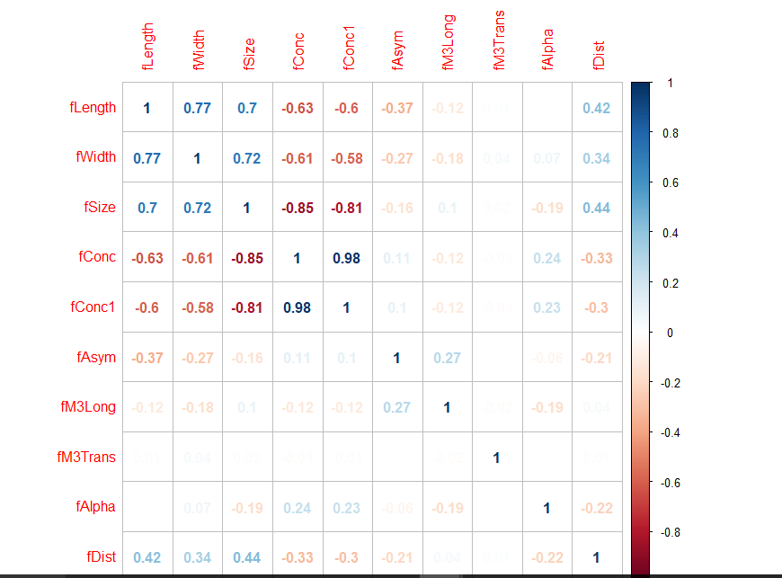
Correlation plot
To know how strong the pairs of variables are related.

Slide 9
Data preparation

Slide 10
Data Preprocessing
PCA
Data Preprocessing is a technique that is used to convert the raw data into a clean data set
(PCA) is to reduce the dimensionality of a data set consisting of many variables correlated with each other.

Slide 11
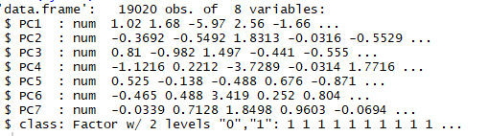
Data after pca, preprocessing

Slide 12
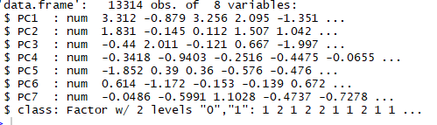
Splitting data into train and test

Slide 13
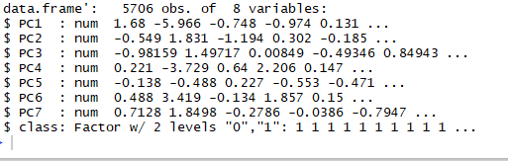
Test data

Slide 14
Model Building

Slide 15
TEST DATA
K-NN
TRAIN DATA
Accuracy : 0.8046
Sensitivity : 0.9193
Specificity : 0.5964
Accuracy : 0.8581
Sensitivity : 0.9464
Specificity : 0.6943

Slide 16
K-NN WITH OUT PCA
TEST DATA
Accuracy : 0.81 Sensitivity : 0.9410
Specificity : 0.5723
TRAIN DATA
Accuracy : 0.8364
Sensitivity : 0.9541
Specificity : 0.6179

Slide 17
K-NN WITH C.V
TEST DATA
Accuracy : 0.8367 Sensitivity : 0.9532
Specificity : 0.6251
TRAIN DATA
Accuracy : 0.8681
Sensitivity : 0.9641
Specificity : 0.6900

Slide 18
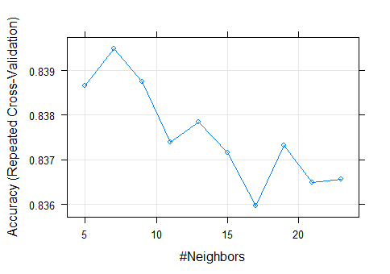
We can see variation in Accuracy w.r.t K value by plotting these in a graph.

Slide 19
DECISION TREE(RPART)
TEST DATA
Accuracy : 0.7836 Sensitivity : 0.9127
Specificity : 0.5491
TRAIN DATA
Accuracy : 0.789
Sensitivity : 0.9129
Specificity : 0.5591

Slide 20
DECISION TREE(C5.0)
TEST DATA
Accuracy : 0.8016 Sensitivity : 0.9195
Specificity : 0.5876
TRAIN DATA
Accuracy : 0.8342
Sensitivity : 0.9396
Specificity : 0.6385

Slide 21
TEST DATA
XGBoost
TRAIN DATA
Accuracy : 0.868
Sensitivity : 0.8549
Specificity : 0.9021
Accuracy : 0.9814
Sensitivity : 0.9722
Specificity : 0.9998

Slide 22
SVM
TEST DATA
Accuracy : 0.7876 Sensitivity : 0.7982
Specificity : 0.7597
TRAIN DATA
Accuracy : 0.7845
Sensitivity : 0.7999
Specificity : 0.7441

Slide 23
SVM WITH OUT PCA
TEST DATA
Accuracy : 0.796 Sensitivity : 0.9038
Specificity : 0.6004
TRAIN DATA
Accuracy : 0.788
Sensitivity : 0.8960
Specificity : 0.5874

Slide 24
SVM TANHDOT
TEST DATA
Accuracy : 0.5648 Sensitivity : 0.6703
Specificity : 0.3735
TRAIN DATA
Accuracy : 0.5582
Sensitivity : 0.6602
Specificity : 0.3688

Slide 25
Logistic Regression
TEST DATA
Accuracy : 0.7639 Sensitivity : 0.7503
Specificity : 0.8244
TRAIN DATA
Accuracy : 0.7654
Sensitivity : 0.7559
Specificity : 0.8064

Slide 26
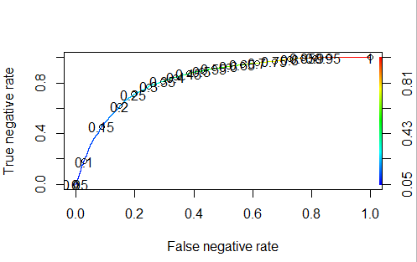

With pca

Slide 27
Logistic Regression without pca
TEST DATA
Accuracy : 0.7587 Sensitivity : 0.7415 Specificity : 0.8457
TRAIN DATA
Accuracy : 0.766 Sensitivity : 0.7497
Specificity : 0.8472

Slide 28
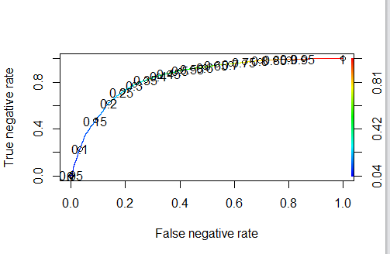

With out pca

Slide 29
ANN
TEST DATA
Accuracy : 0.8041
Sensitivity : 0.9598
Specificity : 0.5215
TRAIN DATA
Accuracy : 0.8654
Sensitivity : 0.9659
Specificity : 0.5864

Slide 30
List of models applied & model results
Trained 6 models using 13,314 records
Tested these models on 5706 records
Error metric used to evaluate the model is : specificity

Slide 31
1. Logistic Regression
2. Decision Tree
Rpart
C5.0
3. Support Vector Machine
4. Xgboost
5. K-Nearest Neighbors
6. Ann

Slide 32
Logistic Regression is the winner
Train Data: specificity : 0.8457
Test Data: specificity : 0.8472

Slide 33
WEAK ALGORITHMS
Random Forest
Bagged Decision Trees

Slide 34
Questions?

Slide 35
Thank-You

